Slide 1
Zum Anfang
In your little green books write (in German):
4 days of the week
3 hobbies
2 opinions
1 connective

Slide 2
Word order rule – Verb Second Idea
The verb must always be the second part or ‘idea’ of the sentence in German.
For example:
ich fahre am Montag Fahrrad
fahre is the verb and must come second in the sentence.
To emphasise the time phrase ‘am Montag’, we can put it at the start of the sentence but we have to move the words around so that the verb is still the second ‘idea’ of the sentence (not necessarily the second word).
Ich fahre am Montag Fahrrad
becomes
Am Montag fahre ich Fahrrad.

Slide 3

Am Montag…

Slide 4

Am Dienstag…

Slide 5

Am Mittwoch…

Slide 6

Am Donnerstag…

Slide 7

Am Freitag…

Slide 8

Am Samstag…

Slide 9

Am Sonntag…

Slide 10

Und schon…

Slide 11
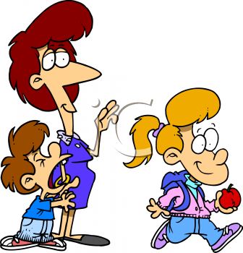
Ja, dann ist der Montag da.

